Slide 1
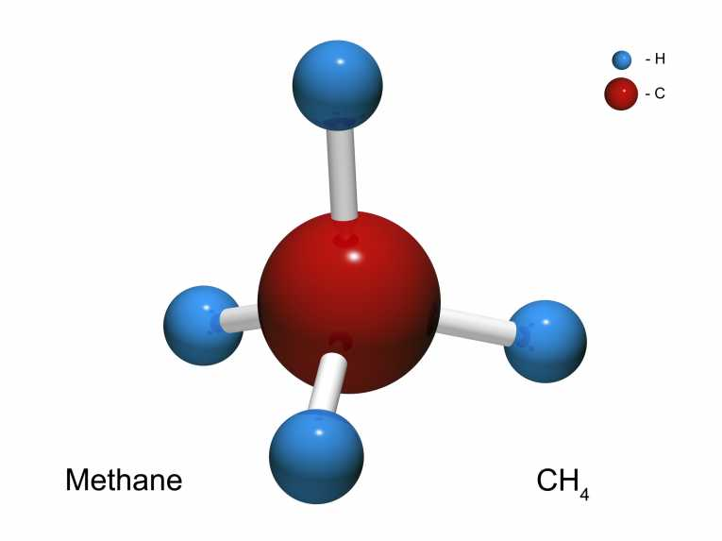

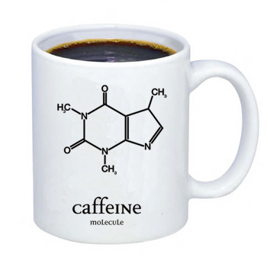
Organic Chemistry
Organic chemistry is the chemistry of carbon-based compounds (also referred to as hydrocarbons) which do not include carbonates, hydrogencarbonates and the oxides of carbon.
(Willett 2015)
(Fitzpatrick 2013)
(NA 2015)

Slide 2
There are more known carbon based compounds than all the inorganic compounds because:
Carbon can bond with itself (self-catenate) in a chain.
Carbon has four valence electrons which means it can form single, double and triple covalent bonds.
The chains it forms remain stable even if they extend hundreds of carbons in length.
They can form ring structures which are stable up to 30 atoms in length.

Slide 3
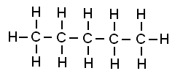

Organic molecules can be represented as molecular formula (eg CH₄, C₂H₄, C₄H₁₀O, etc) or drawn as structural formula.
Eg C₅H₁₂
CH₃‒CH₂‒CH₂‒CH₂‒CH₃
(Allman 2013)
CH₃‒(CH₂)₃‒CH₃
(Wikimedia 2015)

Slide 4
Hydrocarbons can be divided in the following manner:
Hydrocarbons
Aliphatics
Alkanes
Alicyclics
Aromatics
Alkenes
Alkynes
Straight Chain
Ring Structure
Benzene Based
Saturated
U n s a t u r a t e d
Single Bonds
Double Bonds
Triple Bonds

Slide 5
Alkanes
Saturated (ie only single bonds between carbon atoms).
General formula is C_{n}H_{2n+2}.
Part of a homologous series, each differing by CH₂.
Nomenclature (Naming)
Count the longest continuous carbon chain and use the stem name based on this.

Slide 6
Number of Carbons | Stem Name
1 | meth-
2 | eth-
3 | prop-
4 | but-
5 | pent-
6 | hex-
7 | hept-
8 | oct-
9 | non-
10 | dec-

Slide 7
For alkanes, use the suffix –ane.
Eg CH₃CH₂CH₃ CH₃CH₂CH₂CH₂CH₂CH₂CH₃
CH₃CH₂CH₂
CH₂
CH₂ CH₃
CH₂CH₂CH₂
If there is a substituted group (eg halogen), number the carbons such that the substituted group gets the lowest number.
Eg CH₃CH₂CH₂CHCH₃
Cl
propane
heptane
nonane

Slide 8
If there is an alkyl group attached (other carbon atoms that are not part of the main stem – aka branches):
name using stem name based on the number of carbons
add the suffix –yl
place a number in front to indicate its position
CH₃
Eg CH₃CH₂CH₂CHCH₂CH₃ CH₂
CH₃ CH₃CH₂CH₂CH₂CH
CH₂
CH₃CHCH₃ CH₃
CH₃
3-methylhexane
3-ethylheptane
methylpropane* (why??)

Slide 9
If there is more than one of the same substituted group, add the following prefix to the name of the substituted group:
Eg CH₃ CH₃
CH₃CH₂CCH₂CH₂CHCH₂CH₃
CH₃
Number of same substituted group | 2 | 3 | 4 | 5 | 6
Prefix | di- | tri- | tetra- | penta- | hexa-
3,3,6-trimethyloctane

Slide 10
Note that numbers are separated from each other by commas, separated from words by hyphens, there are no capital letters and no spaces.
If there are different types of alkyl groups, write them alphabetically but still number to give lowest positions. Ignore numerical prefixes when alphabetising.
CH₃
Eg CH₃ CH₂
CH₃CCH₂CHCH₂CH₂CH₂CH₃
CH₃
4-ethyl-2,2-dimethyloctane

Slide 11
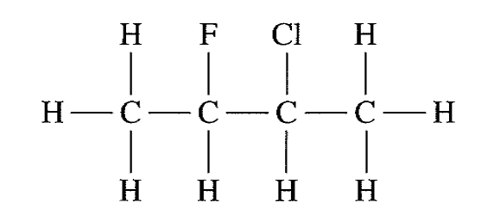

If there are substituted halogens the same rules for naming apply as for alkyl groups but the following names are used:
Eg
Halogen | F | Cl | Br | I
Name | fluoro- | chloro- | bromo- | iodo-
(Tristian 2012)
2-chloro-3-fluorobutane
(Schmitz 2012)
2-bromopentane

Slide 12
If there are substituted halogens and alkyl groups the halogens are written first (although numbering is still according to lowest positions). If it is a tie between a halogen and an alkyl group the halogen gets the lowest number. If it is a tie between two halogens, the first alphabetically gets the lowest number.
Eg I Br CH₃ Cl
CH₃CH₂CHCHCH₃ CH₃CCH₂CHCH₂CCH₃
CH₃ Br CH₃
3-iodo-2-methyl-pentane
2,2-dibromo-6-chloro-4,6-dimethylheptane

Slide 13
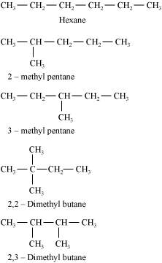
Alkane Isomerism
Isomers are compounds with the same molecular formula but different structural formula. Alkanes can display structural isomerism.
Eg C₆H₁₄ has the following isomers.
(Dua 2011)

Slide 14
Cycloalkanes
Saturated (ie only single bonds between atoms) ring structures.
General formula is C_{n}H_{2n}.
Part of a homologous series, each differing by CH₂.
Nomenclature (Naming)
Add the prefix cyclo- to the stem name.
Eg cyclobutane, cyclodecane, etc

Slide 15
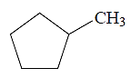
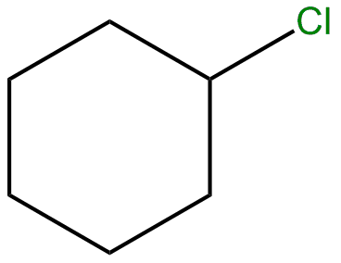
Note the shorthand way of drawing cycloalkanes. Eg
Be careful as most questions ask you to show all atoms, for which this form is not acceptable!
(Mysolutionguru.com 2013)
(Frenkel 2012)

Slide 16
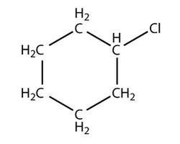
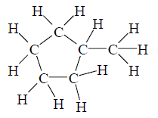

If there is only one substituted group, no numbering is required.
Eg
If there are more than one substituted group, numbering is required (follow alkane numbering rules).
(Neogen Chemicals Limited nd)
(Mysolutionguru.com 2013)
chlorocyclohexane
methylcyclopentane
1,4-dimethylcyclohexane
(pixshark.com nd)

Slide 17
Alkenes
Unsaturated as they contain at least one double bond between carbon atoms.
General formula is C_{n}H_{2n}.
Part of a homologous series, each differing by CH₂.
Nomenclature (Naming)
Count the longest continuous carbon chain that contains the double bond and use the stem name based on this.

Slide 18
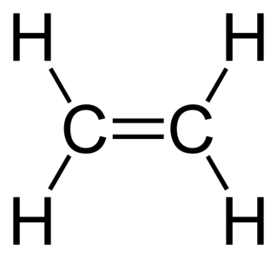
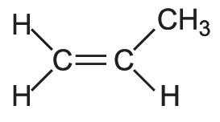

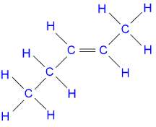
For alkenes, use the suffix –ene.
Eg
A number in front is used to show the position of the double bond.
Eg
(Benjah-bmm27 2006)
ethene
(CIEC Promoting Science at the University of York 2014)
propene
pent-2-ene
hex-3-ene
(Schmitz nd)
(France 2014)

Slide 19
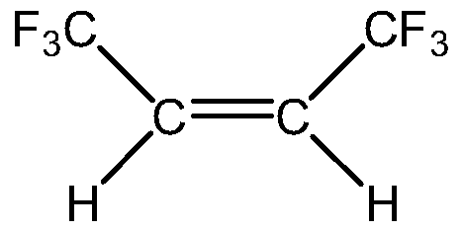

If there are substituted groups they are named following the same way as for alkanes but the double bond always gets the lowest priority.
Eg
(IFI Claims Patent Services 2012)
1,1,1,4,4,4-hexafluorobut-2-ene
(Schmitz nd)
3-methylpent-1-ene
Note: When drawing alkenes always begin at the double bond and angle the remainder of the chain around this.

Slide 20
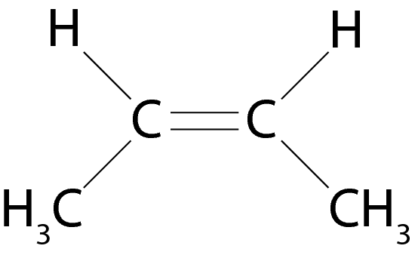
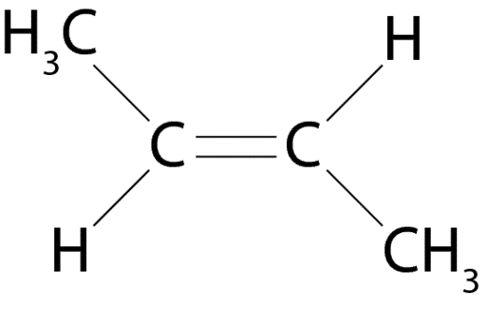
Alkene Isomerism
Unlike single bonds which allow atoms to freely rotate, double bonds do not allow rotation. This gives rise to alkenes which have the same molecular and structural formula but different geometry. This is called geometric or cis/trans isomerism.
Eg
(Chappell 2013)
(Chappell 2013)
cis-butene
trans-butene

Slide 21
Geometric isomers will occur with the following configurations:
Geometric isomers will not occur with the following configurations:
A
A
A
A
D
B
B
B
(Chappell 2013)
(Chappell 2013)
A
B
A
A
A
B
E
D
B
A
A
D
(Chappell 2013)

Slide 22
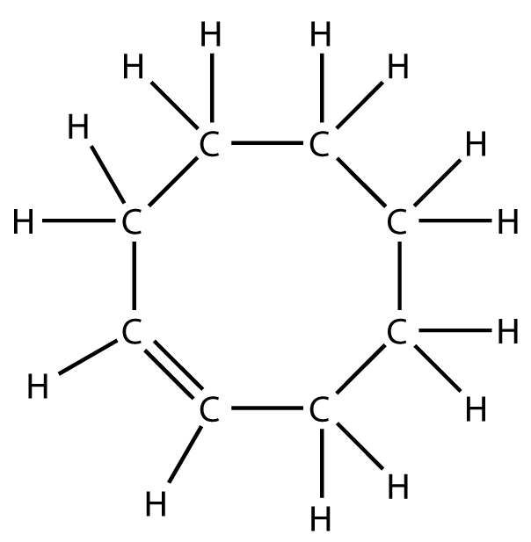
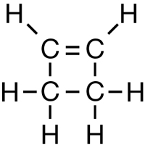
Cycloalkenes
Nomenclature (Naming)
Add the prefix cyclo- to the stem name.
Eg cyclobutene, cyclodecene, etc
If there are no substituted groups, no numbering is required for the cycloalkene.
(NA nd)
(National Science Foundation 2008)
cyclobutene
cyclooctene

Slide 23
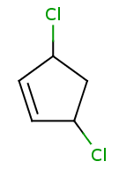
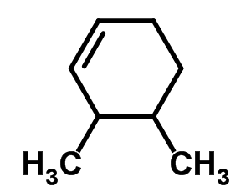
If there are one or more substituted groups they must be numbered (with the double bond getting the highest priority).
Eg
(Guidechem 2010)
(Brower nd)
3,5-dichlorocyclopentene
3,4-dimethylcyclohexene

Slide 24
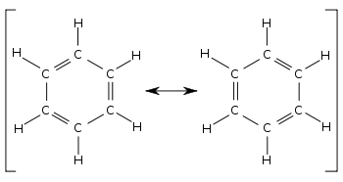
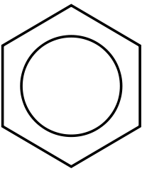
Benzene
Has the formula C₆H₆.
It is a very stable ring structure which has alternating double and single bonds.
(Wikipedia 2015)
(Admin 2012)

Slide 25
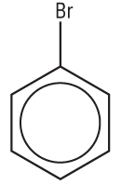
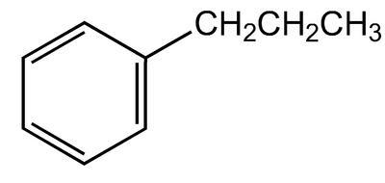
Nomenclature
Add the suffix -benzene to the stem name.
If there is only one substituted group, no numbering is required.
Eg
(VWR International LLC 2015)
propylbenzene
(Imgbuddy nd)
bromobenzene

Slide 26
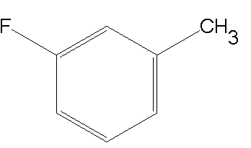
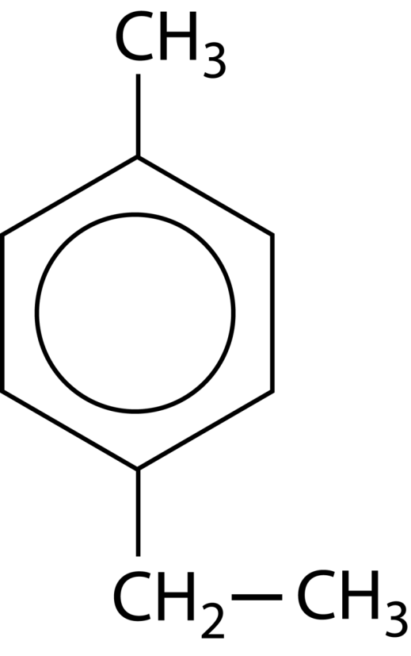
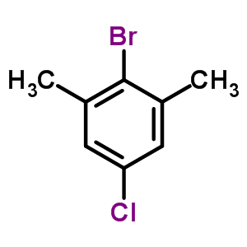
Nomenclature
If there are more than one substituted group, numbering is required (follow alkane numbering rules).
Eg
(Chemsynthesis nd)
1-fluoro-3-methylbenzene
(CK-12 Foundation 2015)
1-ethyl-4-methylbenzene
(Guidechem 2010)
2-bromo-5-chloro-1,3-dimethylbenzene

Slide 27
Melting and Boiling Points
Organic compounds are covalent molecular compounds.
Their melting and boiling points (mp’s and bp’s) depend on the strength of their intermolecular forces.
The stronger the intermolecular forces, the higher the melting and boiling points will be.
This is because more energy is required to overcome the intermolecular forces.

Slide 28
Melting and Boiling Points
For compounds of similar size, mp and bp depends on how close the molecules can get to each other.
The closer the molecules are, the stronger the intermolecular forces and the higher the mp’s and bp’s as more energy is required to overcome these forces.
How close molecules can get to each other is dependent on their stereochemistry (ie shape).
Benzene molecules can get closer to each other than alkanes which can get closer than alkenes.
So, mp and bp for similar chain length is: benzene>alkane>alkene

Slide 29
Melting and Boiling Points
For similar compounds of different size, the larger the molecule (more atoms in the molecule), the stronger the intermolecular forces between them.
The stronger the intermolecular forces, the higher the mp’s and bp’s as more energy is required to overcome these forces.
Eg octane has a higher mp and bp than ethane.

Slide 30
The intermolecular forces in alkanes are greater than in alkenes.
Due to the stereochemistry (shape) of the molecules and the flexibility of the single bonds, alkanes can pack in closer to each other than alkenes.
Benzene has greater intermolecular forces than alkanes and alkenes.
Due to the stereochemistry (shape) of the benzene molecules they can pack in really close to each other.
Also, the larger the molecule the greater the intermolecular forces. Eg octane has a higher mp and bp than methane.

Slide 31
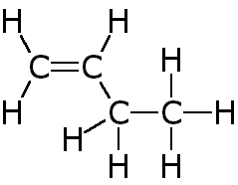
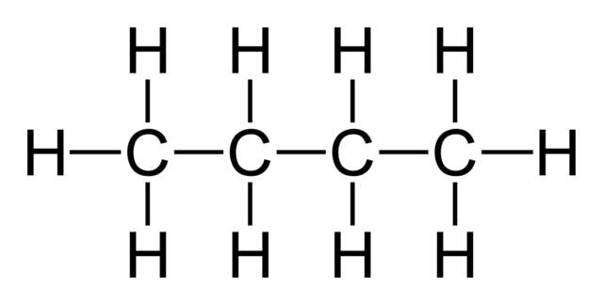
Organic Reactions
Addition Reactions
Occurs in alkenes.
Atoms are added across the double bond converting it to a single bond.
Hydrogenation – the addition of H₂ across the double bond (requires heat and Ni, Pt or Pd catalyst).
Eg but-1-ene + H₂
+ H_{2(g)}
∆, Pd
(Wikimedia Commons 2014)
(Clarkson 1997)

Slide 32
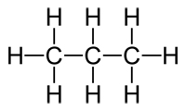
Halogenation – the addition of a halogen across the double bond.
Eg propene + F₂
F
F
+ F_{2(g)}
(CIEC Promoting Science at the University of York)
(Edinformatics 1999)
Hydrohalogenation – the addition of a hydrogen halide across the double bond.
The hydrogen will go to the carbon with the most hydrogens already and the halogen on the other carbon across the double bond (Markovnikov’s rule).

Slide 33
(Markovnikov’s rule).
The hydrogen will go to the carbon with the most hydrogens already and the halogen on the other carbon across the double bond.

Slide 34

Eg propene + HCl
Cl
+ HCl
(CIEC Promoting Science at the University of York)
(Edinformatics 1999)
If both carbons have the same amount of hydrogens the product will be a 50/50 mix of the two products.
Eg cis-pent-2-ene + HI
I
+HI
+
I
(Chemical 2015)
(France 2014)

Slide 35
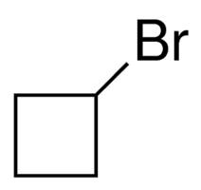
Substitution Reactions
Occurs in alkanes and benzenes.
A hydrogen atom is pulled off to allow a halogen to be placed on in its place. A hydrogen halide is also produced.
Alkanes require UV and benzenes require an AlBr₃ catalyst.
Eg cyclobutane + Br₂
UV
+ Br₂
+ HBr
(Sigma-Aldrich Co 2015)

Slide 36
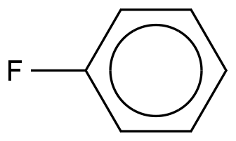
Eg benzene + F₂
AlBr₃
+ F₂
+ HF
Combustion Reactions
Occurs with all hydrocarbons.
In excess oxygen it produces CO_{2(g)} and H₂O_{(g)}.
In limited oxygen it produces CO_{(g)} and H₂O_{(g)}.
This is the only organic reaction where molecular formulae are allowed.

Slide 37
Eg hex-2-ene reacts with excess oxygen
C₆H_{12(l)} + 9O_{2(g)} 6CO_{2(g)} + 6H₂O_{(g)}
Eg octane is burnt in limited oxygen
2C₈H_{18(l)} + 17O_{2(g)} 16CO_{(g)} + 18H₂O_{(g)}

Slide 38
BIBLIOGRAPHY
Admin. "Chemistry is Fun: Benzene Series (Part A)." Gigabase. March 29, 2012. https://blog.gigabase.org/en/contents/50 (accessed April 15, 2015).
Benjah-bmm27. "Ethene-2D-flat.png." Wikimedia Commons. 2006. http://commons.wikimedia.org/wiki/File:Ethene-2D-flat.png (accessed March 21, 2015).
Brower, Keith. "3,5-dichlorocyclopntene." Chem Sink. nd. http://www.chemsink.com/compound/12430199/ (accessed March 23, 2015).
Chappell, Isaac. "4D, N=1 Supergravity Genomics." Inspire. 2013. https://inspirehep.net/record/1207316/plots (accessed March 25, 2015).
Chemical. "But 1 ene." Chemicals. 2015. http://www.chemicalpics.com/but-1-ene/ (accessed April 21, 2015).
Chemsynthesis. "1-fluoro-3-methylbenzene." Chemsynthesis. nd. http://www.chemsynthesis.com/base/chemical-structure-8514.html (accessed April 14, 2015).
CIEC Promoting Science at the University of York. "Poly(propene) (Polypropylene)." The Essential Chemical Industry Online. January 2, 2014. http://www.essentialchemicalindustry.org/polymers/polypropene.html (accessed March 22, 2015).
CK-12 Foundation. "25.3 Aromatics." CK-12. 2015. http://www.ck12.org/book/CK-12-Chemistry---Second-Edition/section/25.3/ (accessed April 15, 2015).
Clarkson, R. "AQA Unit 1 - Alkenes." Chmeistry Rules in Brunei. November 1997. http://www.chemistryrules.me.uk/candr/alkenes.htm (accessed April 20, 2015).
Dua, Shveta. "Carbon and Its Compounds." Merit Nation. 2011. http://www.meritnation.com/ask-answer/question/how-many-isomers-are-for-c6h14-and-what-are-they/science/685934 (accessed March 21, 2015).
Edinformatics. "Interactive Molecules." The Interactive Library. 1999. http://www.edinformatics.com/interactive_molecules/3D/propane_molecule.htm (accessed April 20, 2015).
Fitzpatrick, Alex. "Supreme Court: Scientists Can't Patent Naturally Occurring DNA." Mashable Australia. June 2013. http://mashable.com/category/dna/ (accessed March 17, 2015).
France, Colin. "Products from Oil." GCSE Science. 2014. http://www.gcsescience.com/o12.htm (accessed April 21, 2015).
Frenkel, Michael. "Chlorocyclohexane." NIST/TRC Web Thermo Tables. 2012. http://wtt-pro.nist.gov/wtt-pro/index.html?cmp=chlorocyclohexane#chlorocyclohexane/aa2;50,50,508,424/aa1;100,100,508,424/A;0,0,508,424;help,about/ (accessed March 21, 2015).
Guidechem. "C8H8BrCl." Guidechem. 2010. http://www.guidechem.com/product/search_C8H8BrCl_w-formula-p1.html (accessed April 15, 2015).
—. "CAS No. 2808-72-2 (3,4-dimethylcyclohexene)." Guidechem. 2010. http://www.guidechem.com/cas-280/2808-72-2.html (accessed March 23, 2015).
IFI Claims Patent Services. "Compositions and Uses of cis-1,1,1,4,4,4-hexafluoro-2-butene." Patents. 2012. http://www.google.com/patents/EP2513023A2?cl=en (accessed March 22, 2015).
Imgbuddy. "Bromobenzene." imgbuddy.com. nd. http://imgbuddy.com/bromobenzene.asp (accessed April 14, 2015).
Mysolutionguru.com. "Organic Chemistry." My Solution Guru. 2013. http://www.mysolutionguru.com/organic-chemistry/525/ (accessed March 21, 2015).
NA. "Unit C Diagnostic Self-Check." Moodle. nd. http://moodle2.rockyview.ab.ca/mod/book/tool/print/index.php?id=57668&chapterid=33975 (accessed March 21, 2015).
National Science Foundation. "Z-Cyclooctene." ChemEd DL. 2008. http://www.chemeddl.org/resources/models360/models.php?pubchem=638079 (accessed March 23, 2015).
Neogen Chemicals Limited. "Chloroalkane Compounds." Neogen Chemicals Limited. nd. http://www.indiamart.com/neogenchemicals/chloro-alkane-compounds.html (accessed March 21, 2015).
pixshark.com. "1,4-dimethylcyclohexane." Pixshark.com. nd. http://pixshark.com/1,4-dimethylcyclohexane.htm (accessed March 21, 2015).
Schmitz, Adam. 2012 Book Archive. nd. http://2012books.lardbucket.org/books/introduction-to-chemistry-general-organic-and-biological/s16-02-cis-trans-isomers-geometric-is.html (accessed March 23, 2015).
Sigma-Aldrich Co. "Bromocyclobutane." Sigma-Aldrich. 2015. http://www.sigmaaldrich.com/catalog/product/aldrich/226998?lang=en&region=AU (accessed April 21, 2015).
Tristian. "Portfolio Experiment #20." Dr Blurg. November 29, 2012. http://drblurg.blogspot.com.au/2012/11/portfolio-experiment-20.html (accessed March 23, 2015).
VWR International LLC. "n-propylbenzene 98%." VWR. 2015. https://us.vwr.com/store/catalog/product.jsp?product_id=7492761 (accessed April 13, 2015).
Wikimedia Commons. "Butane 2D Flat." Wikimedia Commons. November 2014. http://commons.wikimedia.org/wiki/File:Butane-2D-flat.png (accessed April 20, 2015).
Wikipedia. "Resonance (Chemistry)." Wikipedia. April 2015. http://en.wikipedia.org/wiki/Resonance_(chemistry) (accessed April 17, 2015).
Willett, Nicole. "The Curious Case for Methane on Mars, Methane and Active Organics Discovered on Mars." The Mars Society. January 2, 2015. http://education2.marssociety.org/the-curious-case-for-methane-on-mars-methane-and-active-organics-discovered-on-mars-issue-32/ (accessed March 17, 2015).

